Slide 1
Central America and the Caribbean

Slide 2
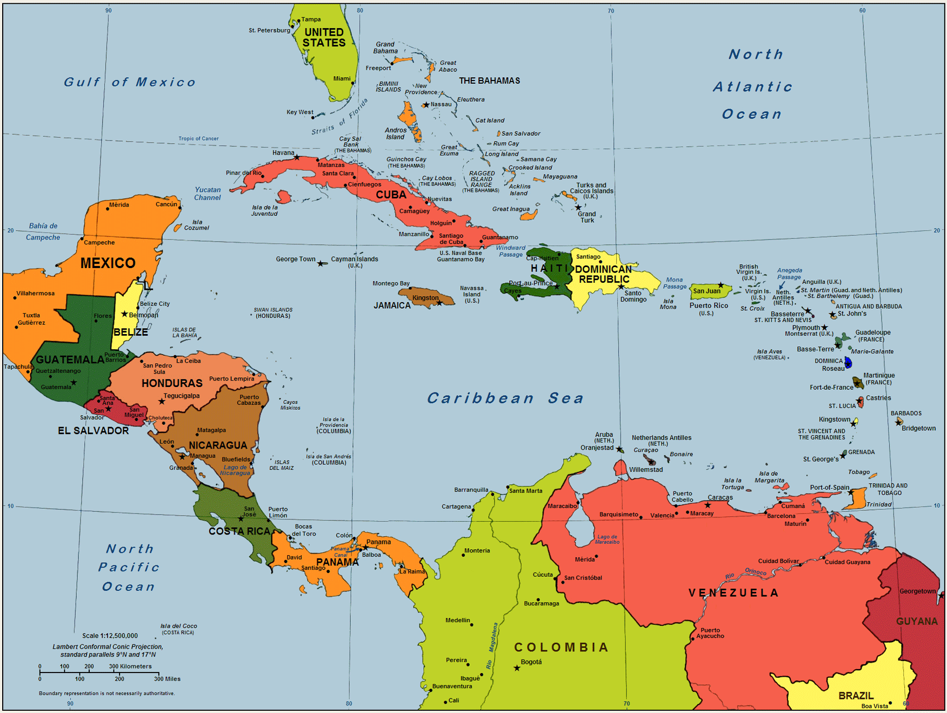

Slide 3
-Central America: isthmus that connects North and South America
-Mayan Influence: centrally located in Mexico, but the Maya also built cities in Belize, Guatemala, El Salvador, and Honduras

Slide 4
-United Provinces of Central America: name that Central American nations established when independence was gained from Mexico in 1823
-By the late 1830s, the United Provinces had split into separate nations

Slide 5
-Islands throughout the Caribbean were colonized by European powers
-Spain: Cuba, Dominican Republic
-France: Haiti
-Great Britain: Jamaica, Barbados
-Independence for most of these countries was achieved in the 1800s

Slide 6
-Culture of Central America: blend of native influences and Spanish influences
-Spanish language and Catholic religion still exist today

Slide 7
-Culture of the Caribbean: influences of colonizing countries such as Spanish, French, British, and Dutch
-Combined with native influences as well as African influences
-Many slaves were brought to the Caribbean to work on sugar plantations
-Major religion is Christianity; most are either Catholic or Protestant
-Languages spoken include Spanish, French (Haiti), English (Jamaica)

Slide 8
Economies of Central America and the Caribbean
-Most countries in this region are relatively poor
-This is mostly due to the legacy of colonialism
-Profits of the sugar crops benefitted the colonial planters and not the native and African laborers

Slide 9
Economies of Central America and the Caribbean
-Major crops from Central America and the Caribbean: sugar cane, bananas, citrus fruits, coffee, and spices
-The pay for people working to harvest these crops is quite low, which contributes to the collectively poor status of the nations
-The Panama Canal is an extremely important asset to global trade

Slide 10
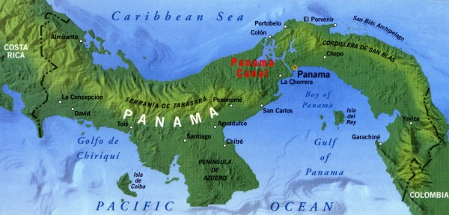

Slide 11
Economies of Central America and the Caribbean
-Rapid population growth is contributing to high unemployment, especially for young people
-Lacking proper skills, knowledge is also a contributing problem
-Tourism is an extremely important industry
-Locals work in hotels, resorts, and restaurants

Slide 12
Economies of Central America and the Caribbean
-Many people are also a part of the informal economy, which does not provide benefits to workers
-These positions include street vending, shining shoes, selling food, etc.
-Provides an unstable, relatively small income that depends heavily on tourism

